Slide 1
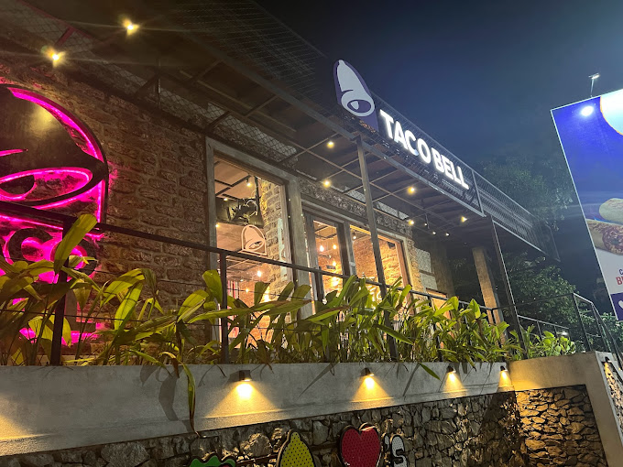
Lighting Review of
TacoBell
Rathnayake R.M.S.U
29290

Slide 2
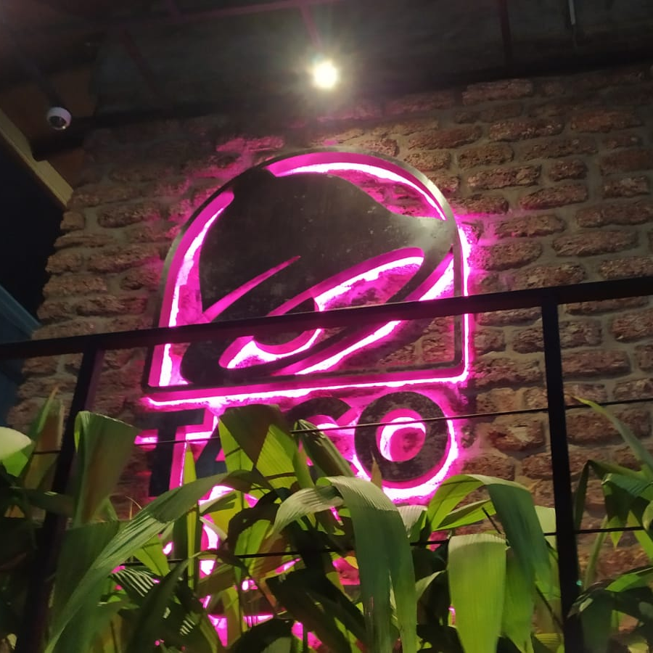
Content
Introduction
Types of lights
Lighting layout
Other lighting strategies implemented
Mood and atmosphere
Issues and solutions

Slide 3
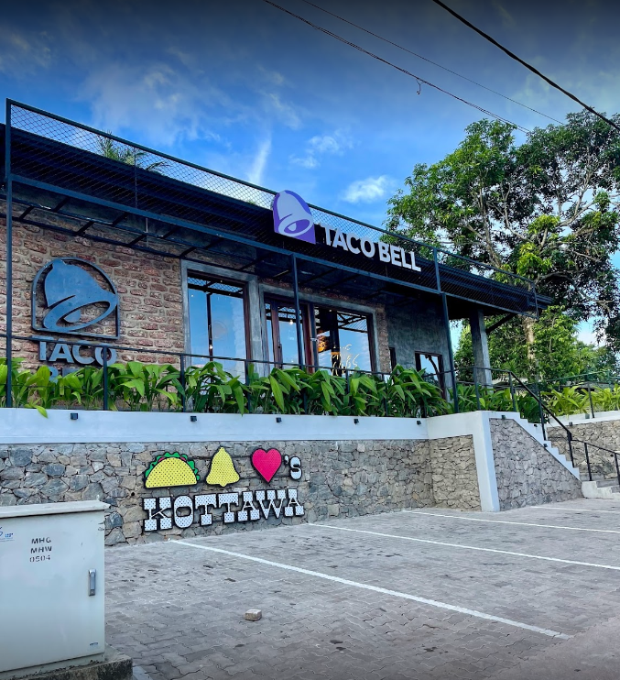
Introduction
Taco Bell Corp. is an American multinational chain of fast-food restaurants founded in 1962 by Glen Bell in Downey, California. Taco Bell is a subsidiary of Yum! Brands, Inc.
There are more than 30 countries where Taco Bell has more than 8000 restaurants.
Here, I have selected the Taco Bell Kottawa restaurant as my reference for the lighting review.

Slide 4
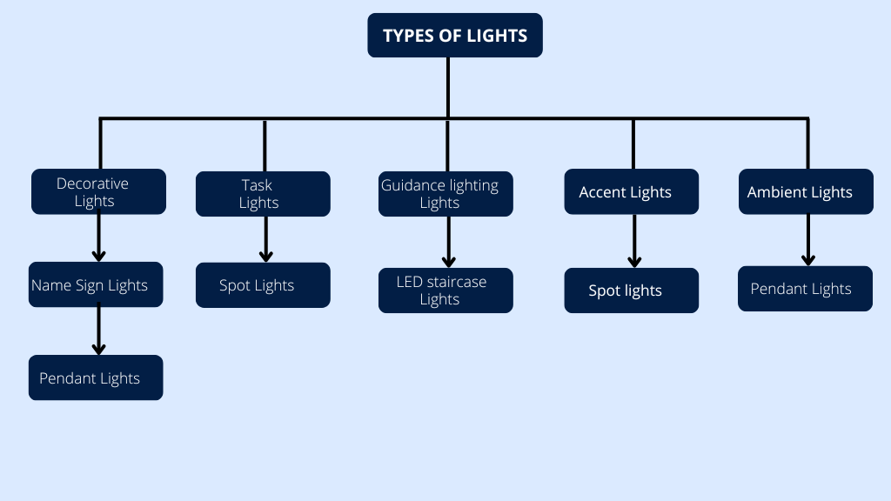

Slide 5
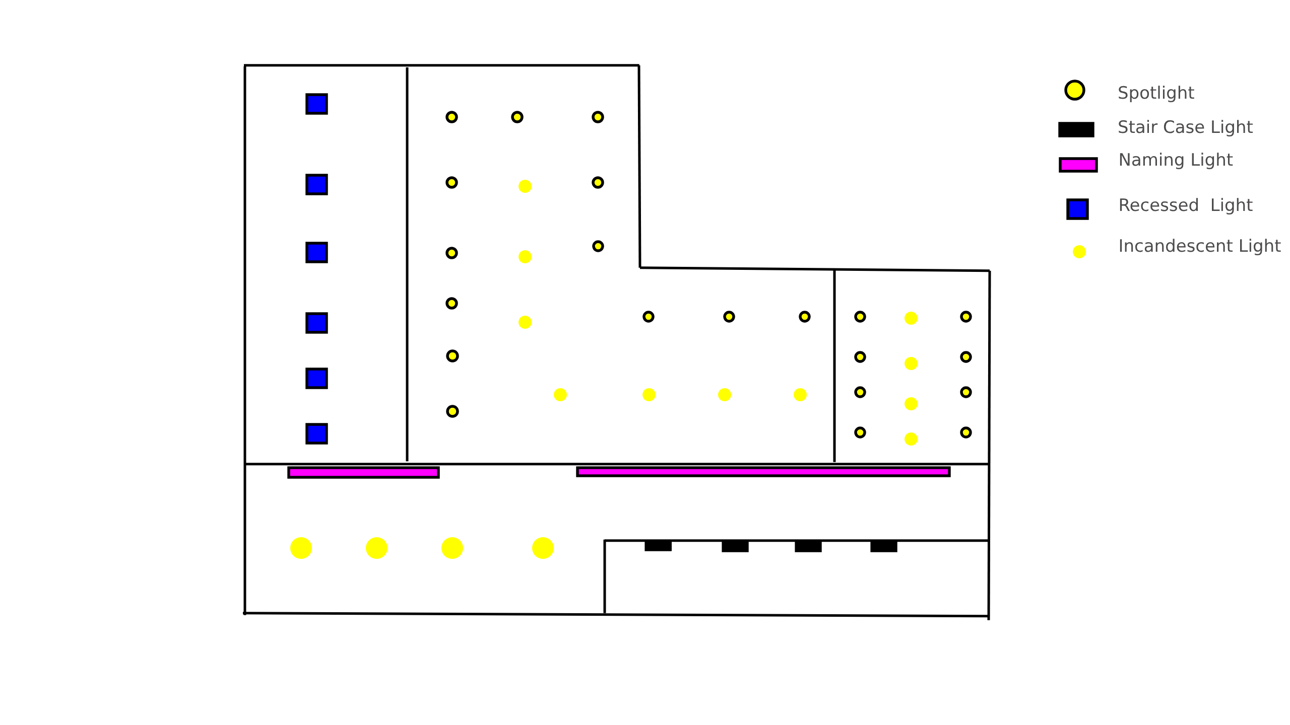
Lighting Layout

Slide 6
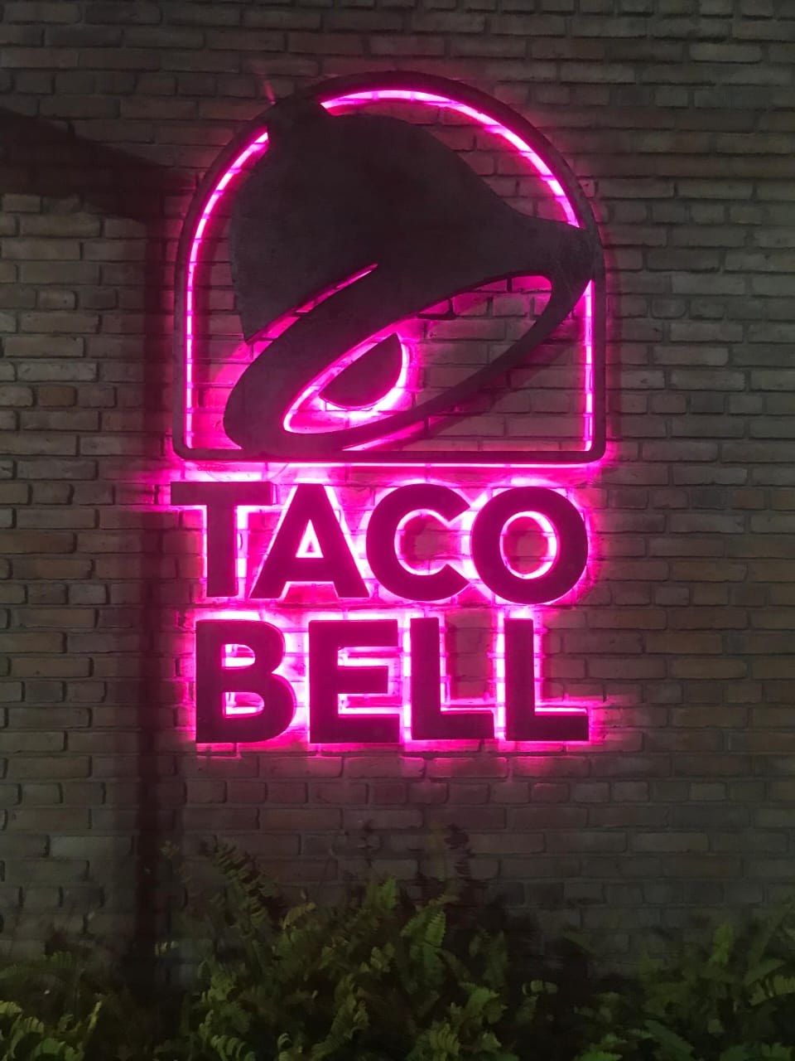
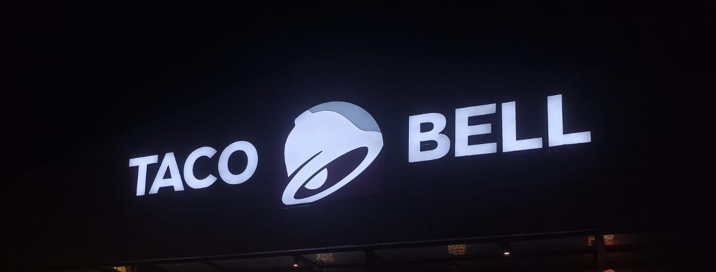
LED Backlit light for the name sign
The sign is made to be easy to see from far away, which helps people recognize the brand and attracts customers.
Mounted on wall and roof
It grabs the attention of passersby.

Slide 7
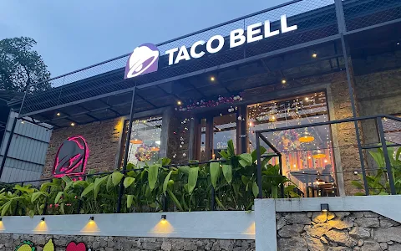
LED neon light - Specification
Type - Led Backlit Sign Office Signage BL-22120201
Material - Stainless steel
Working Lifetime- 100000 hours
Installation Way - screw
Light colors - Pink
Color Rendering Index - 80
Color temperature - 4000K
Luminous Flux: 600lm
Type -

Slide 8
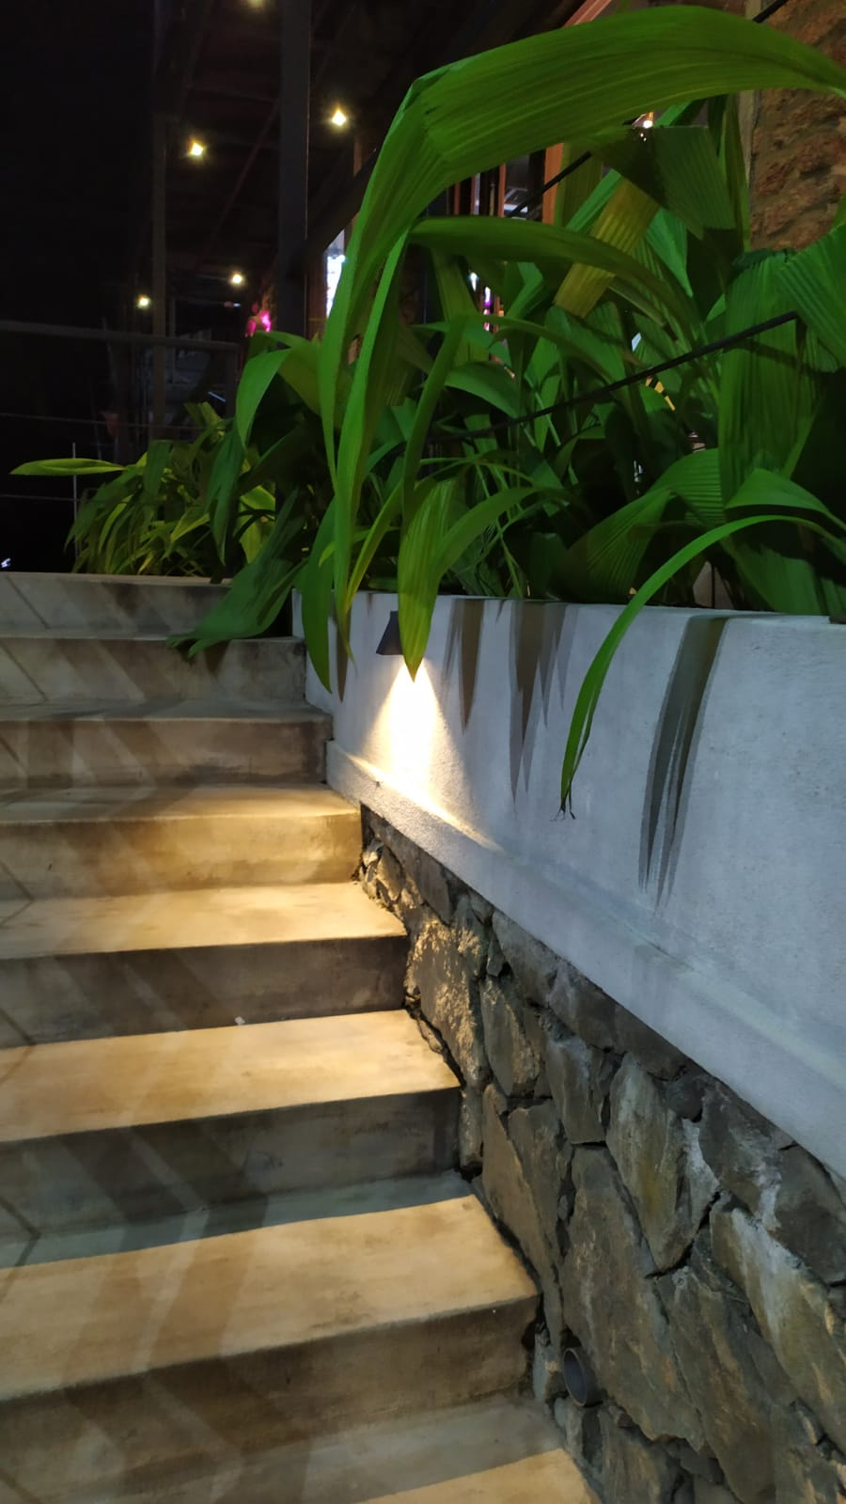
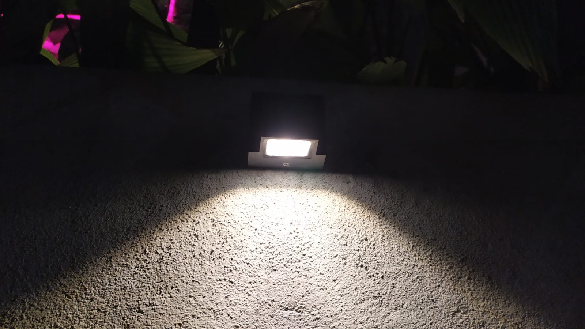
Staircase LED lights
Staircase lights are strategically installed to illuminate each step and ensure safe navigation.
Mounted along the stairs, these lights guide users effortlessly to their destination.

Slide 9
Staircase LED lights - specification
Type - LED Step Light
Material - Plastic
Working Lifetime- 120000 hours
Installation Way - Reassessed In
Light colors - Warm White
Color Rendering Index - 40
Color temperature - 2000K
Luminous Flux: 200lm

Slide 10
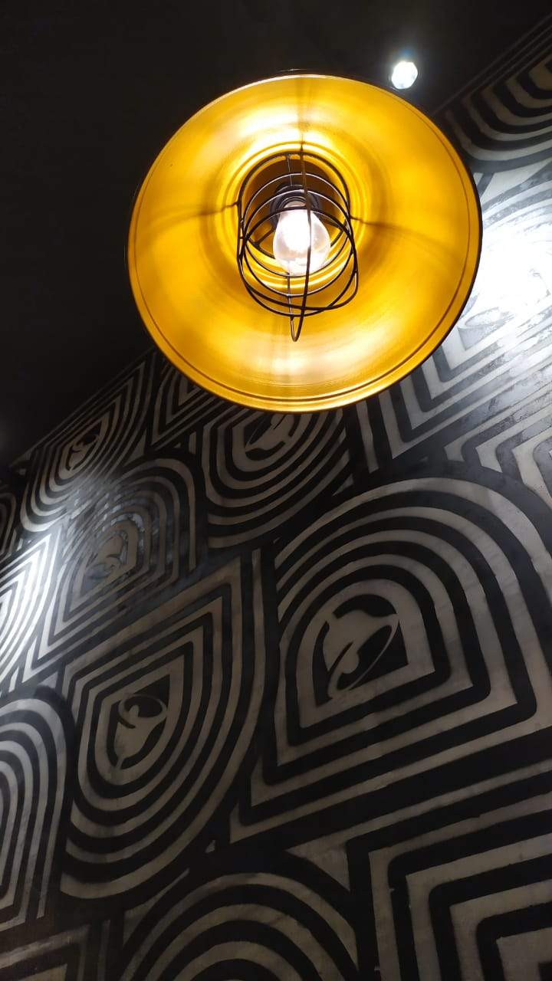
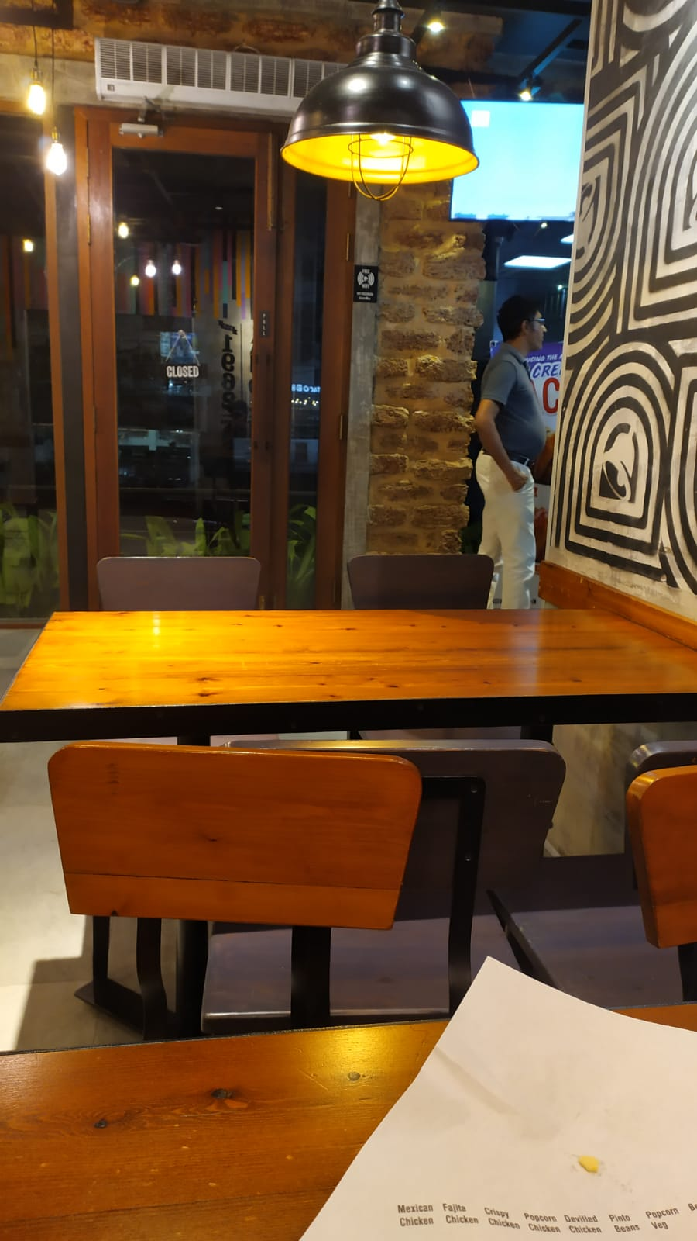
Pendant lights
- Hanging lights brighten the indoor dining space.
- This lighting method emphasizes diners inside.
- Soft, warm light with a touch of gold creates a cozy atmosphere.
- Installed on the ceiling.

Slide 11
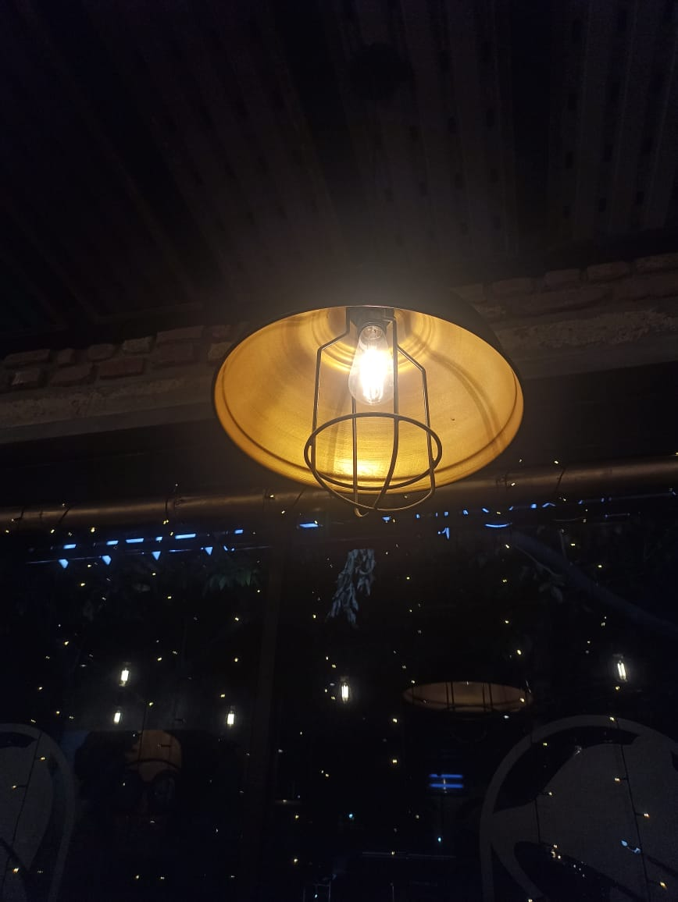
Pendant lights - specifications
Type - Bubble Ball Bulb
Material - glass
Working Lifetime- 60000 hours
Installation Way - Reassessed In
Light colors - Yellow
Color Rendering Index - 70
Color temperature - 2700K
Luminous Flux: 700lm

Slide 12
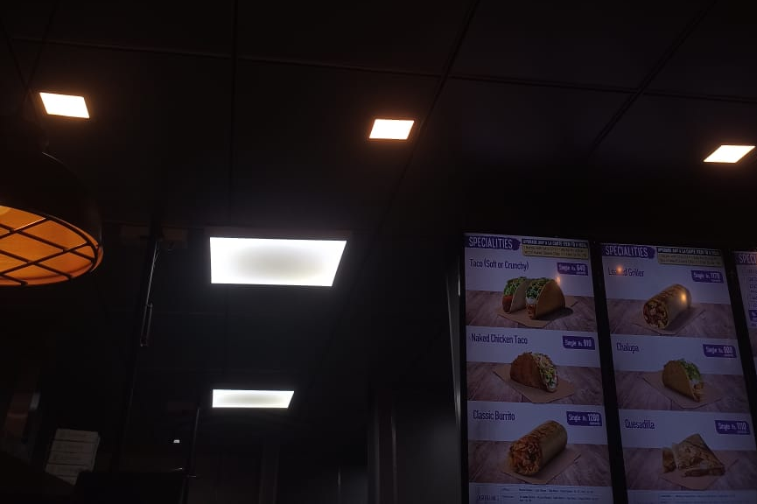
Recessed light
Used in kitchen area
provide a clean and minimalist look by blending into the ceiling

Slide 13
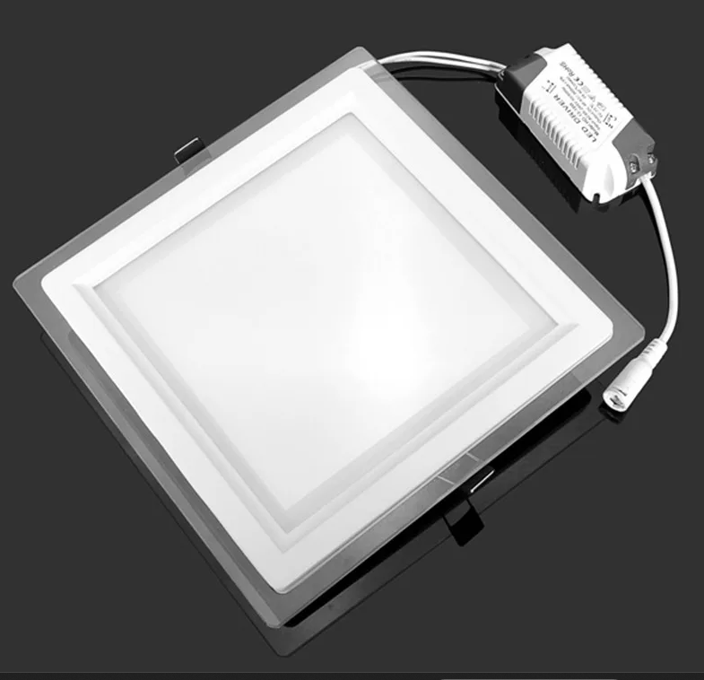
Recessed light - specification
Type - Led panel lights
Material - Aluminum
Working Lifetime- 60000 hours
Installation Way - Downlights
Light colors - WHITE
Color Rendering Index - 80
Color temperature - 2700K
Luminous Flux: 960lm

Slide 14
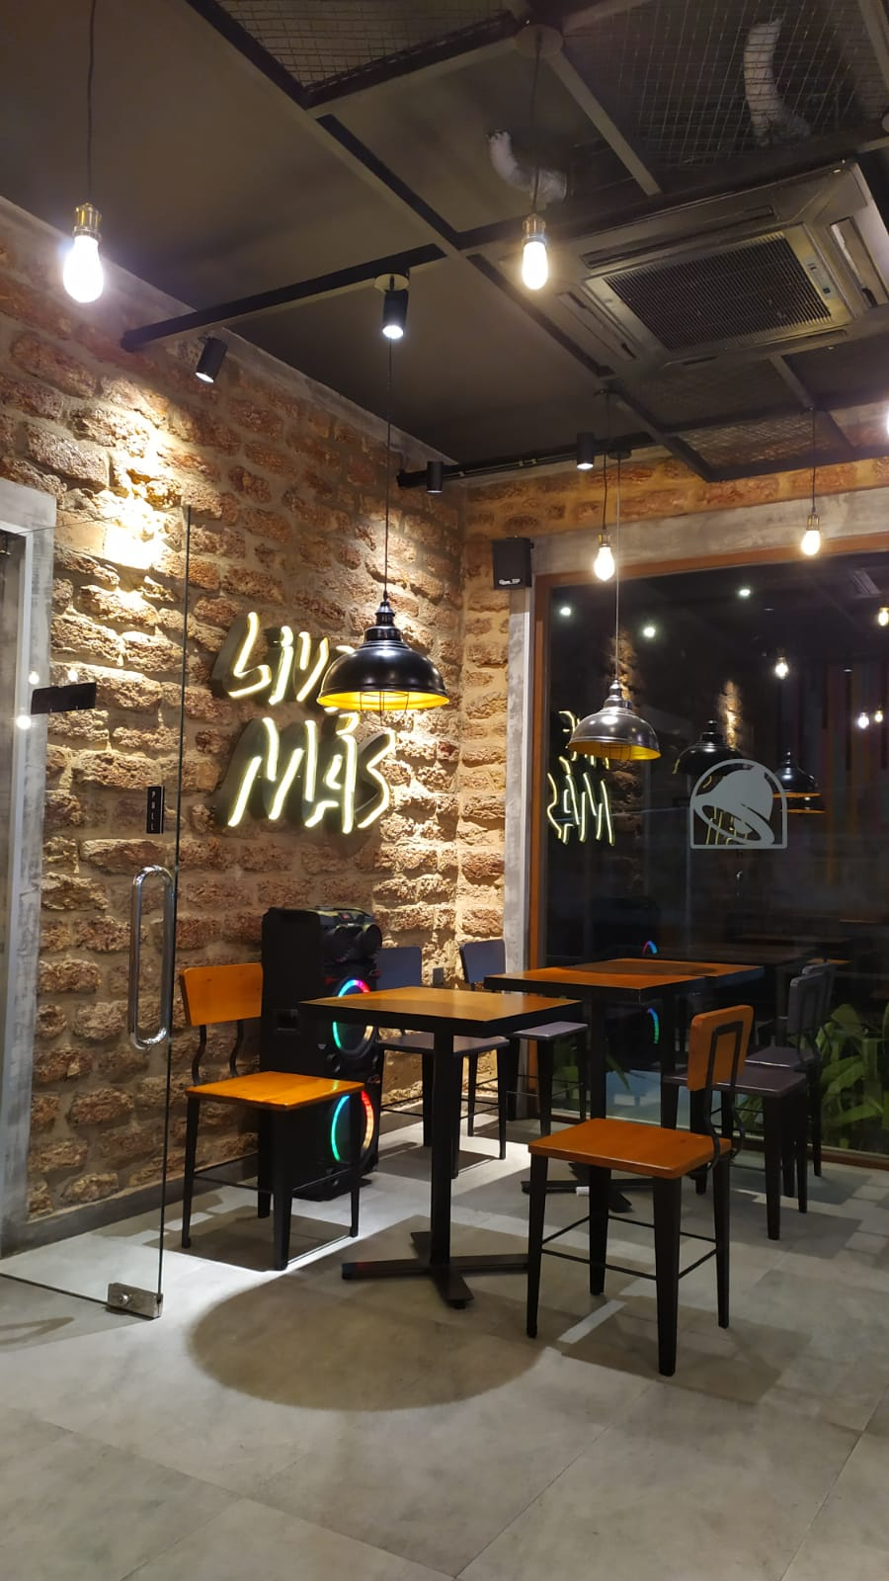
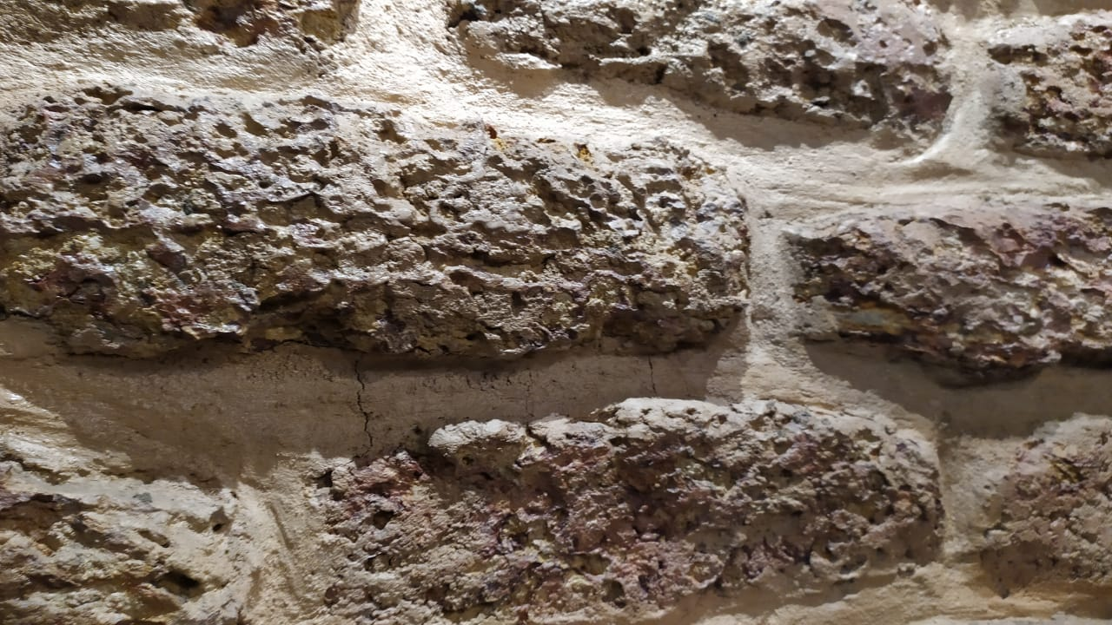
Spotlight
Spotlights are focused on the working stations of the kitchen and walls
Using cool white lighting helps enhance the appearance of a brick wall.
Mounted on ceiling

Slide 15
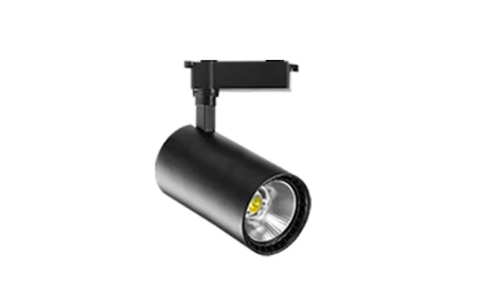
Spotlight specification
Type - Track Lighting
Material - Polished Steel
Working Lifetime- 70000 hours
Installation Way - screw
Light colors - WHITE
Color Rendering Index - 70
Color temperature - 4000K
Luminous Flux: 1000lm

Slide 16
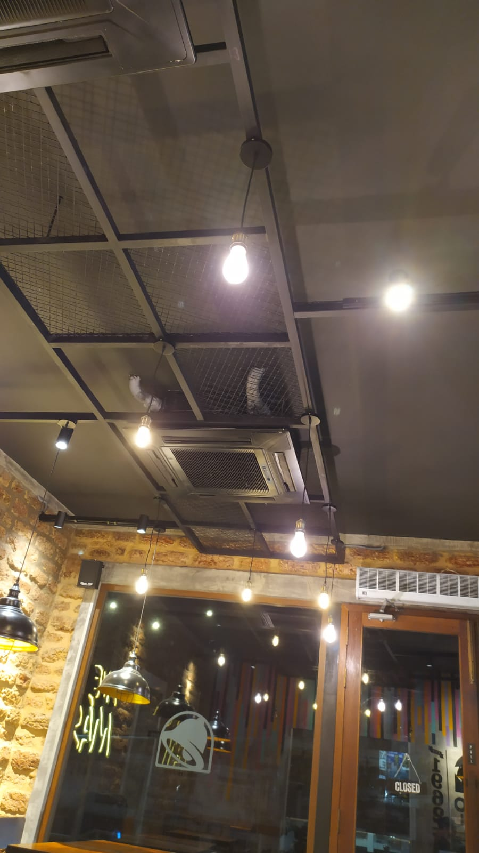
Incandescent lights
These bulb give vintage theme where the ambiance is designed to evoke a sense of nostalgia or a specific time. Incandescent bulbs, especially those designed to resemble classic Edison bulbs, are popular choices for these themes because they contribute to the overall vintage aesthetic and can complement other retro-style decor elements.

Slide 17
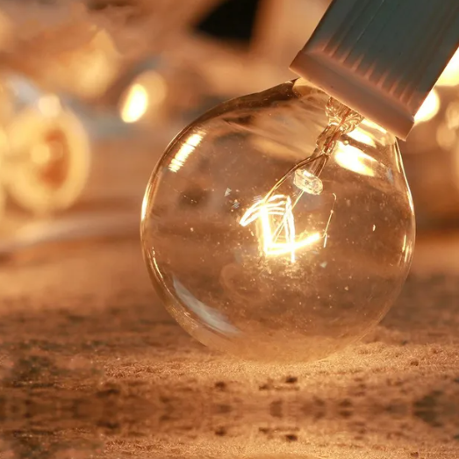
Incandescent lights - specification
Type - Incandescent Bulbs
Material - Glass
Working Lifetime- 100000 hours
Light colors - Warm White
Color Rendering Index - 70
Color temperature - 2200K
Luminous Flux: 600lm

Slide 18
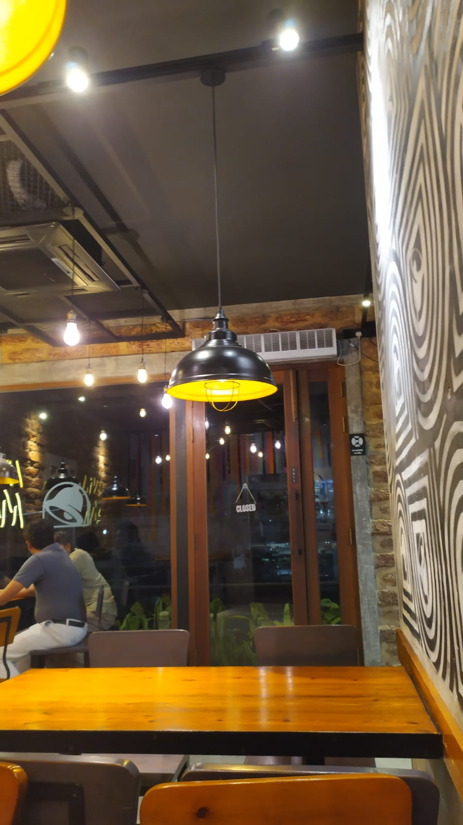
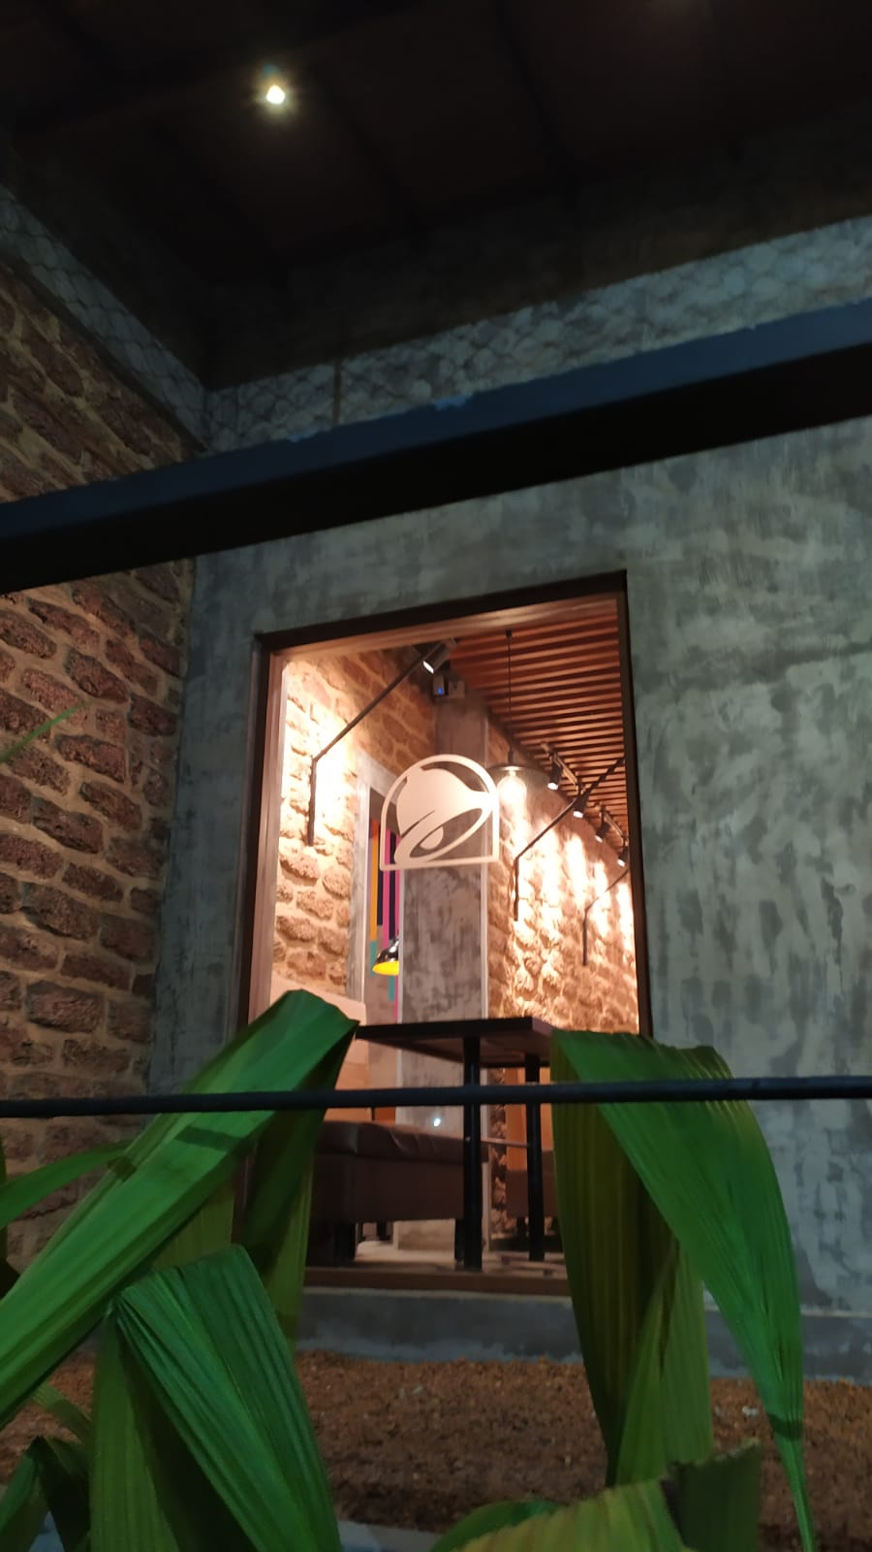
Other lighting enhancement strategies
During the day, they effectively use natural light by placing windows all around.
At night, the windows have glass panels that reflect the indoor lights, making the space brighter.

Slide 19
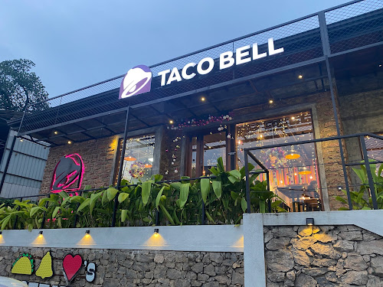
Mood and atmosphere - Outside
Pathway lights ensure safe navigation.
Creates a calming and relaxing vibe.
Provides an inviting ambiance.
It illuminates the restaurant's name or logo in a bold, eye-catching manner

Slide 20
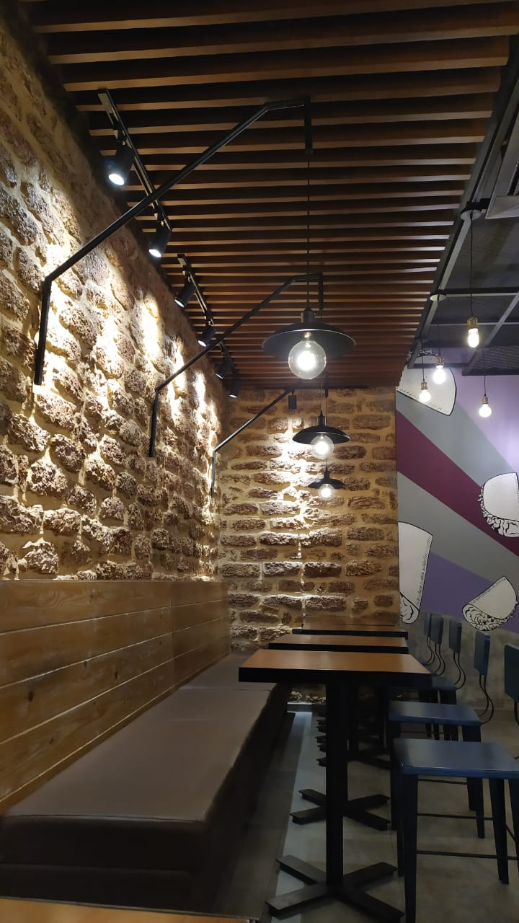
Mood and atmosphere – Dining area
Warm white lights are used to accentuate the vibrant colors of the dining tables, emphasizing their wooden texture.
Creates a fun and lively atmosphere.
Provides a peaceful ambiance, offering a relaxing escape from everyday hustle and bustle.

Slide 21
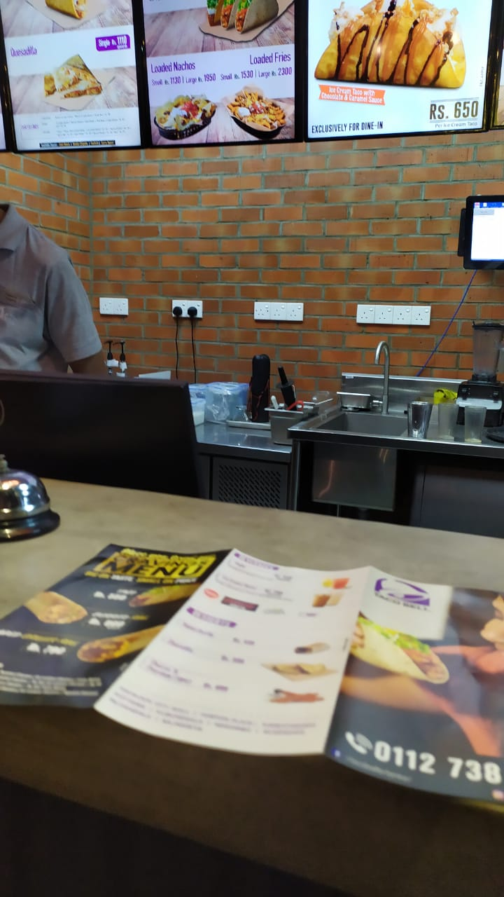
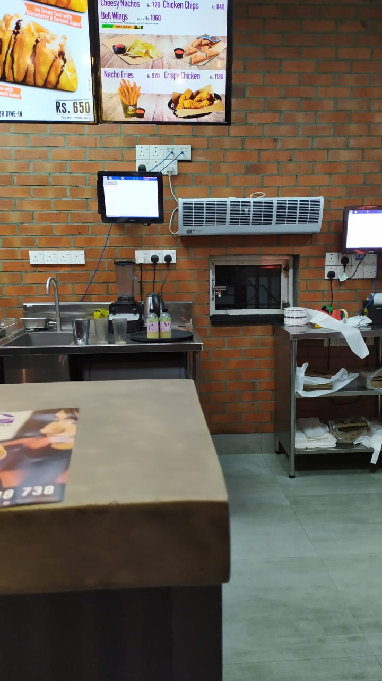
Mood and atmosphere – Kitchen, serving area
Cool yellow lights
Convey a sense of cleanliness and orderliness.
Low visibility and effectiveness.

Slide 22
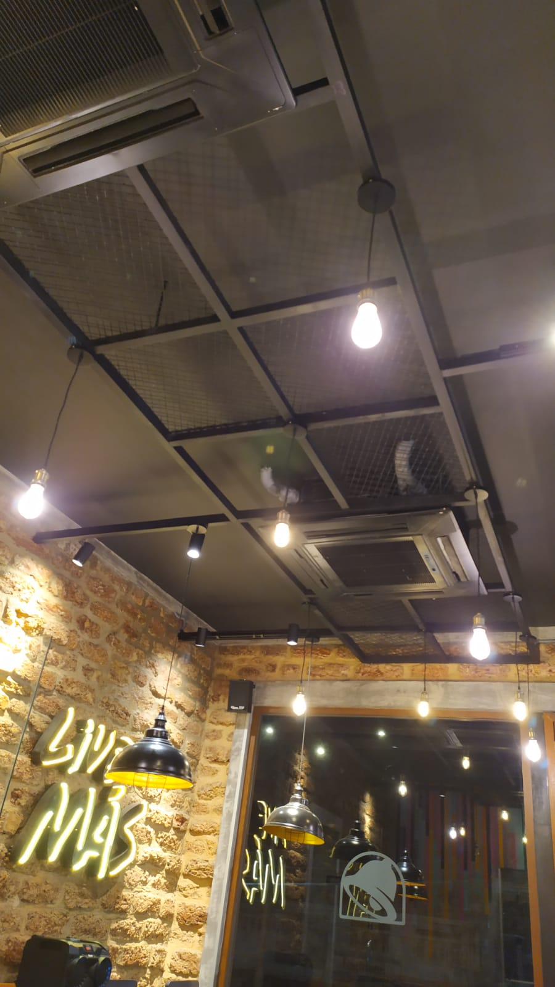
Identified Issues
Multiple light sources overwhelm the eye, making it difficult to focus on specific elements in the space. This can distract from the overall ambiance or intended focal points of the area.
Excessive lighting can cause harsh glares and reflections, on shiny surfaces like glass or polished materials.

Slide 23
Identified Issues
The naming board inside is not clearly visible. To improve visibility, reduce the extra light around it and focus more light directly on the board.

Slide 24
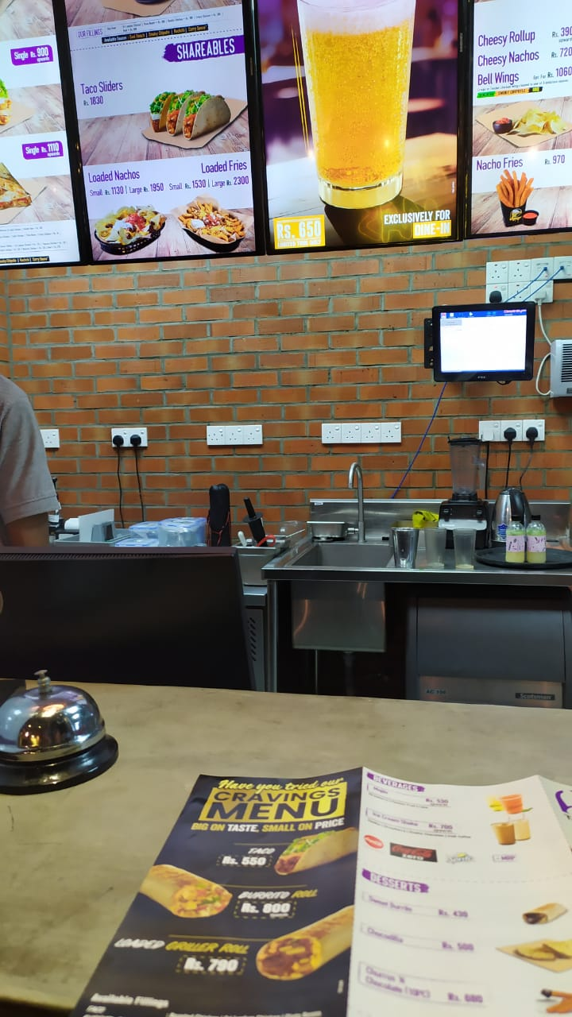
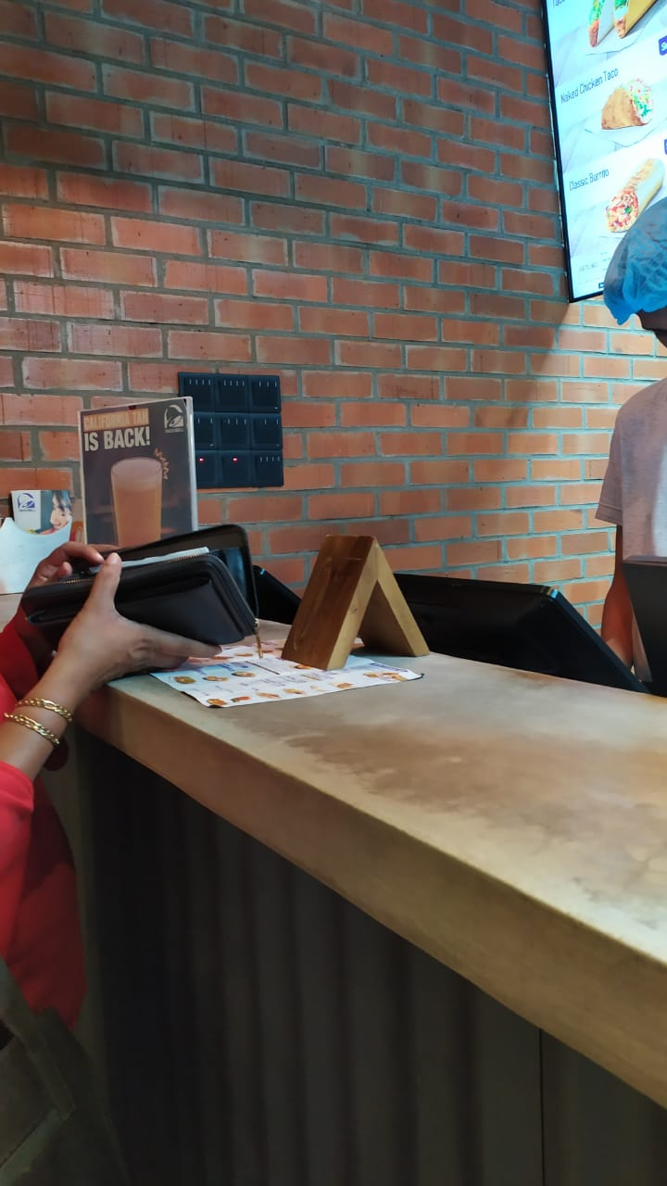
Identified Issues
Proper task lighting in the serving area helps staff work comfortably by reducing eye strain and fatigue caused by poor lighting.
Solutions:
Remove unnecessary lights from the dining area to create a more comfortable environment for the eyes.
Adding spotlights to the serving area helps improve visibility.

Slide 25
Thank You ..!

